Slide 1

E-Road Management System
SRS Presentation
P2011-072

Slide 2
Introduction
This presentation defines the Software Requirement Specification for the E-Road Management System (ERMS).
  Purpose
The main objective of ERMS is providing a real time “traffic, accident and road block” attentions to the Clients through several ways.
In addition to this several other services embed as well, through EPI,ESA,EMT & EDMS.

Slide 3
  Scope
The E-Road Management System broken into four different modules they are:
    E-Path Identifier
    E-Destination Management System
    E-Statistical Analyzer
    E-Mobile Tracker

Slide 4
E-Path Identifier,
    Objective :
    ERMS provide best path to the Motorist with the help of Google Map. By avoiding traffic, accidents and road blocks.
    Goals :
    Efficient traffic controlling.
    Automated response to emergency vehicles .
    Benefits :
Optimization of traffic flow by synchronization between neighboring traffic signals.
Ensuring faster passage for emergency vehicles like ambulances, fire engines etc...

Slide 5
E-Destination Management System,
    Objective :
    EDMS provide best destination services for the new visitors to the host Country.
    Goals :
    Providing better tourism services,
    Centralize all information's of the destination management service providers information and enable the users to gain good service.
    Benefits :
Transport services plays a huge role in a growth of a Country and tourism provides is the major income in our Country. To get gain more income, EDMS provided with a web base system.

Slide 6
E-Statistical Analyzer,
    Objective :
    The best idea to plan the future is get to know the past, this so this module carries a simulator.
    Goals :
    With the help of simulator estimate the future motorways,
            Among the user’s this will provide better time managements.
    Benefits :
Manage a variety of input files for multiple scenarios.
            Compare output results from multiple simulation runs.
Generate nicely formatted reports, and charts for inclusion in reports and presentation slides.

Slide 7
E-Mobile Tracker,
    Objective :
    Using a mobile phone also Clients can get to know or identifies best path by entering the destination point.
    If Client needs the system will provide alternative transport services pointing in Google Map such as Bus stands, Train stations and flight services.
    Goals :
    Improvement and development of new business models requires mobile providers to accurately understand their subscribers' usage.
    Benefits :
Mobile operators, the need for service differentiation is urgent. Reach the user more efficiently.

Slide 8
  Overview
        Main Goals :
    The major objective is to implement a system that can be run automatically when an accident or road block or traffic identified in a particular road. That points Geocode comes as an input, and provide the alternative path to our Clients.
    Provide better destination management service and centralize all destination management service providers.
    Mobile accessibility to reach the user more frequently.
        Task :
    Build up user friendly system ,
    Provide reliable information's.
        Users :
        Motorists,
        Tourist,
        Traffic Police…

Slide 9
System Diagram
Our system Diagram going to show how its going to generate in a way through flash.
All four module as one in diagram.
It will show the more clear idea and easy to identify what will happen in our system.
DiagramNew.swf

Slide 10
User Requirements
Product perspectives
Traffic Monitoring and providing the alternative path is aimed on ERMS that goes through a lot of trouble in allocating the alternative path according to the user requirement with the help of Google Map.

Slide 11
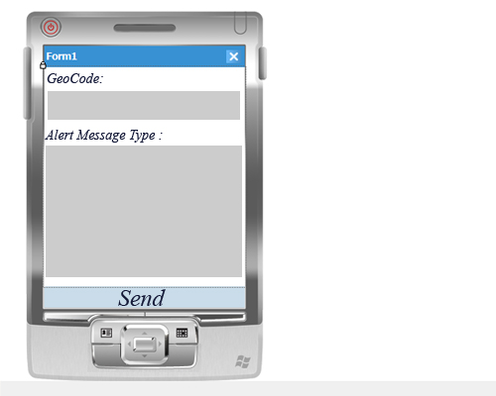
System Interfaces,
EPI :

Slide 12
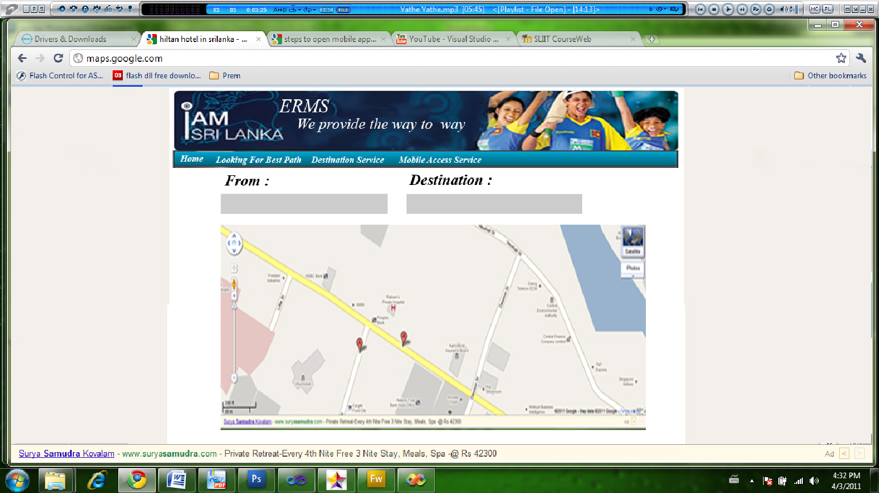

Slide 13
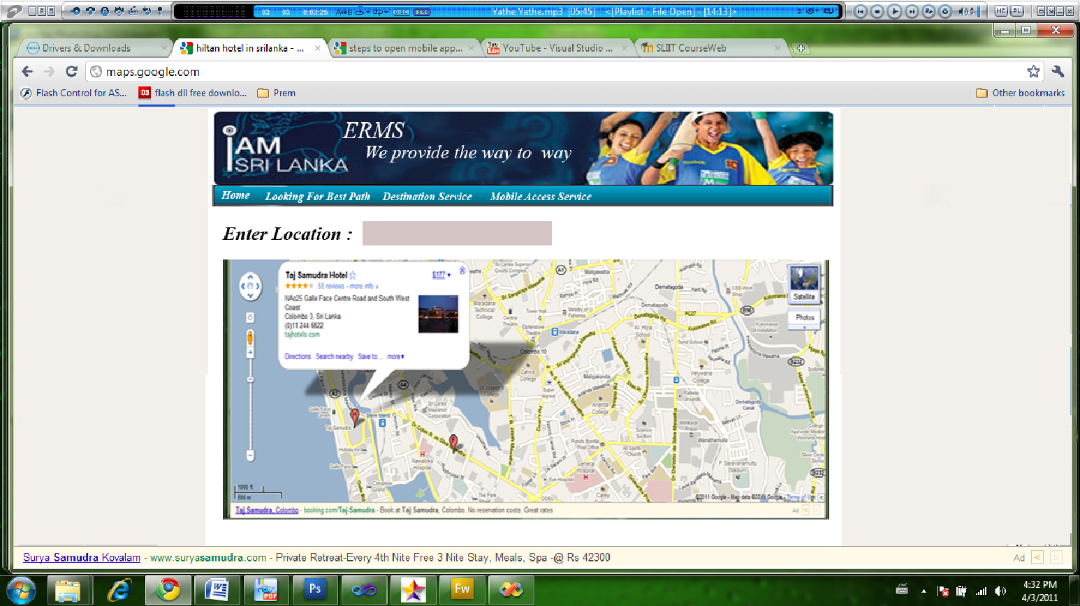
EDMS :

Slide 14
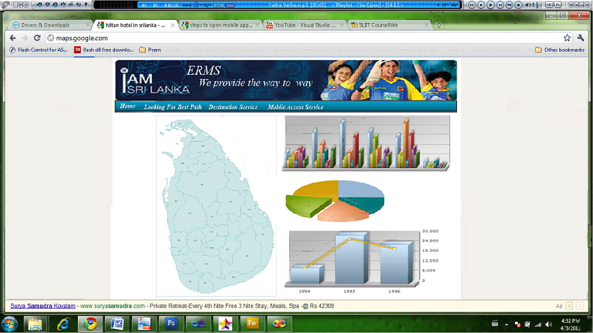
ESA :

Slide 15
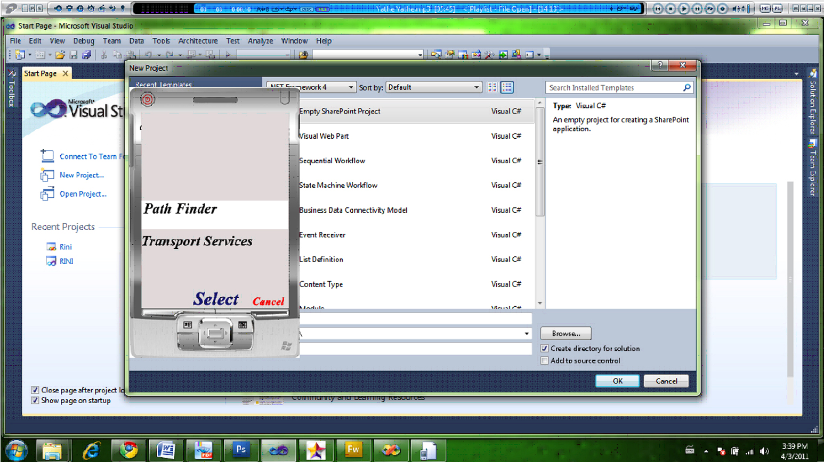
EMT :

Slide 16
System Requirements
The term system requirements means.
It can refer to the requirements that describe the product itself, with the meaning that the product is a system.
System Requirements can be divvied into two,
            Software Requirement
            Hardware Requirement

Slide 17
Software Requirement
E-Road Management System (ERMS) use the visual Studio 2010 for developing and MS-SQL 2008 server for database storage management.
The system development phase use the c# language that run on the .NET 4.0 Framework.

Slide 18
Hardware Requirement
ERMS (E-Road Management System) is using following hardware interfaces.
      PC (Personal Computers)
      Server
      Mobile phones

Slide 19
System Requirements For Internal and External Users
Internal User | External User
Visual Studio 2010 | Flash Payer Plug-in 2010
MS SQL 2008 | Processor 2.0GHz minimum
Flash CS3 | 3G Mobile Phone
3G Mobile Phone | Framework 4.0
Minimum memory 512MB | Minimum memory 512MB
Windows enable Server

Slide 20
External user use 3G mobile for access the ERMS System.
Internal user use for update the system(eg:-police update traffic and accidents)
The server should able to access the visual studio 2010 and MSSQL 2008.
The processor minimum requirement is 2.0GHz , to external and internal use.

Slide 21
Functional Requirements
    F1. Road block location indicate to the system.
Input : - Geocode of the location.
Output: - System update,
Auto generate alerts with location pointed in the Google Map send to Hospital or Police Station according to the type of the road block.
Process: - After system gets the geocode it will point it the Google Map which is hosted in ERMS server.
According to the road block type system will auto generate alerts to the relevant help service providers.
Description:- Providing best path to motorist with the help of Google Map.

Slide 22
    F2. Request for alternative path.
Input : - Enter Destination Point.
Output: - With the help of the Google Map least available path and avoiding all road blocks the path is given,
Process: - System identifies the current and destination points (Geocode) by using that system start searching for the best alternative path.
To this mathematical operations used.
Description:- Providing best path to motorist with the help of Google Map.

Slide 23
F3. Destination Services
      Input: - Enter the place (E.g. Colombo by typing) or by using voice identifier.
      Output: - In a web applications system will point the place in the Google Map. And brief
      Process: - System will automatically generate.
      Description:- Client can search a place (E.g.: Colombo) and in on enter. The system will provide with pointing the place in Google Map and it may pointing all important places in that location just like Hospitals, Airport, Railway Station, Police Station.

Slide 24
      Input: - Enter the place (Eg: Colombo)
      Output: - System will point the place in Google Map.
      Process: - System will automatically generate.
      Description:-.Client can search a place (E.g.: Colombo) and in on enter. The system will provide with pointing the place in Google Map and it may pointing all important places in that location just like Hospitals, Airport, Railway Station, Police Station.
    F2. Point the appropriate place when the person enters the entire place.

Slide 25
    F3. Auto generation statistical graphs and Simulator to predict the future.
    Input : Select form of the graph and enter the value
    (user input).
    Output :Displaying graph according the selection and Will display what will happen in the future when no of vehicles increase.
    Process : System produce the graph
    Description : Provide auto generation graphs and predict the future.

Slide 26
    F4. Provide alternatives paths and transport services through the mobiles.
    Input : Enter Places from where to where he/she wants to go and request for transport service.
    Output :Display path using Google map
    Process : Provide path and transport services details.
    Description :Provide path using Google map and transport service.

Slide 27
Non-Functional Requirements
    Ease and reduce the work load of the end users
    Increase the reliability and efficiency of the work process
    Provide more capabilities in order to fulfil user requirements up to the maximum level.
    Increase user friendliness towards the system
    Interoperability of the system.
    Security requirements will be included in the system.

Slide 28
Reference
Hughes, B. & Cotterell, M.; 2001; Software Project Management; 2nd Edition; New Delhi: Tata McGraw-Hill Publishing Company Limited
Louis, J.Goodman; 1996/ 2001; Project Planning & Management; First Ed; New Delhi; CBS Publishers & Distributors.
Effective Project Management for Web Geeks [online] (updated13th June), p.01-02

